Slide 1
Bibliometrics Analysis of Authors
(Wiley team 4)
Instructor: Christopher Asakiewicz
Authors: Jiahui Bi,
Hongyi Chen,
Shan Gao,
Yuyi Yan

Slide 2




Team Members
Jiahui Bi
Yuyi Yan
Shan Gao
Hongyi Chen

Slide 3

Introduction
The overall US publishing industry is financially healthy, the average revenue of scientific journals has grown by nearly 60% from 2010 to 2017.
We are looking for methods to identify future leading authors in a specific scientific field.

Slide 4
Project Goal
Analyze the impact factor of the authors
Analyze the Co-authorship
Analyze funding, publication features and its correlation with impact factor
Validate the top 5 authors in bio-material area in 2013-2015
Technology
Python for cleansing the data collected from Web of Sciences.
Python & Tableau for generating visualizations for EDA.
Python for network analysis and modeling.
VOSviewer for generating Co-authorship network visualization.

Slide 5
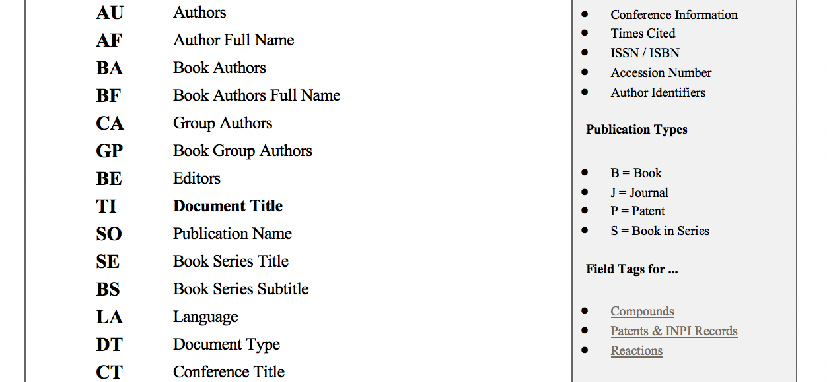
Data Source & Variables
Web of Science core collection
Topic: Biomaterials, from 1990 to 2019
Total: 46409, 68 variables
…

Slide 6
Constructed the Author Dataset
AF
aAuthor_1;aAuthor_2;aAuthor_3;aAuthor4;…; aAuthor_n
bAuthor_1; bAuthor_2;…
First Author | Co- Author_1 |  |  | Co-Author_n
aAuthor_1 | aAuthor_2 | … | … | aAuthor_n
bAuthor_1 | bAuthor_2 | … | … | …
First author
Author | Feature1 | Feature2 | …
aAuthor_1
aAuthor_2
…
aAuthor_n
bAuthor_1
Split the Author column.
Use single author as the granularity of the author dataset.

Slide 7
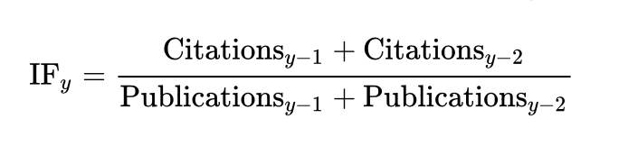
Why Impact Factor?
Impact Factor is used to reflect the average number of citations divided by the total number of articles post on the journal recently. IF is frequently used as a proxy for relative importance of a journal. Higher IF indicates higher importance than lower ones:
We sum up the IF of the articles published by a certain author, considering the year of publication in the journal.
Total impact Factor of a certain author, during a time period, can reveal the quality of his published researches.

Slide 8
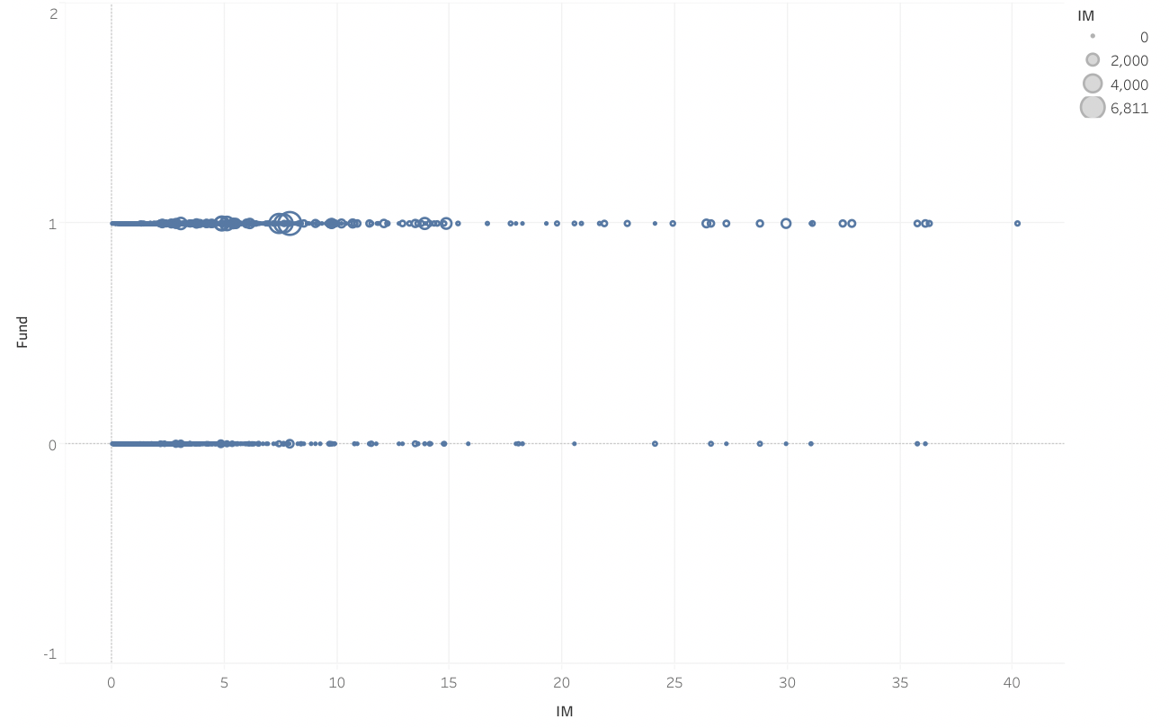
Why funding?
Funding & Impact Factor
Funded articles are more likely published on a journal with high Impact factor.

Slide 9
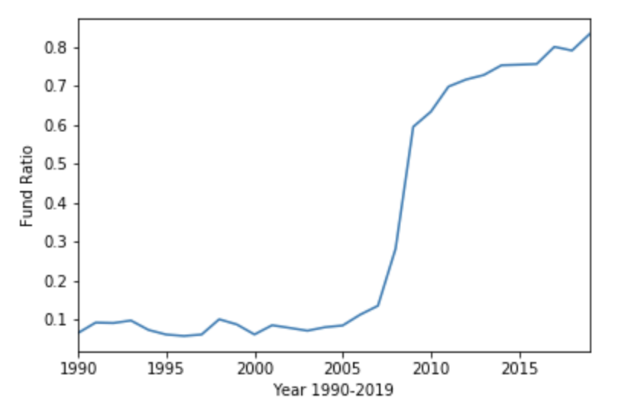
Why funding
Funding & Publication over year
After 2010, more than 65% articles get funded.
At 2009, funding & publication ratio has a cliff growth.

Slide 10
Co-authorship
The article with 4 or 5 authors is most common.
Total 366 articles have only one author, considering 7745 articles during 2010-2012.

Slide 11
Co-author Network
Co-author Directed Network
The Co-authorship network is formed if two authors(node) co-authoring an article together(edge). The edges are directed from the lead author to the other authors. The larger the node is, the more research the author participated.
Lead author
(Ying Ding, Scientific collaboration and endorsement: Network analysis of co-authorship and citation networks, J Informetr. 2011 January 1; 5(1): 187–203. )

Slide 12
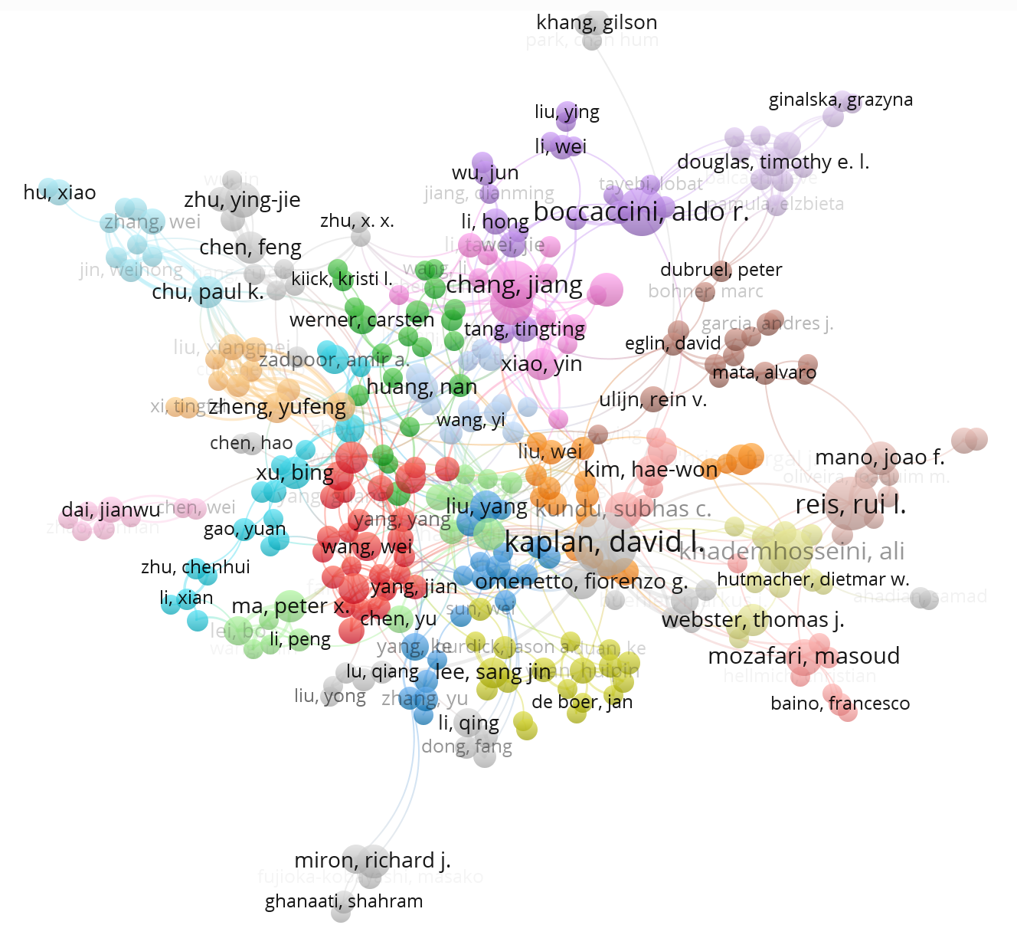
Co-authorship Analysis
The authors with high centrality are always active corresponding authors. It’s a good indicator to consider their co-authorships to detect potential authors.
As it is a directed network, the outdegree and indegree of a certain node, reflect the information about the times the author act as the first author and the number of the research participated in.

Slide 13
Time Gap
Feature: Constructed from author dataset from 2010 to 2012, by two groups, all authors and first author.
Res Variable: The sum of impact factor from 2013 to 2015.
Predicted future top authors by using current features.
Used articles published after 2010 to construct author dataset.
Considered Funding & Publication ratio after 2010, it is remarkably different.
After 2010, the new published articles have exceeded more than 2000 every year.

Slide 14
Feature Selection
Feature correlations
Network features:
Centrality
Degree
Publication, Funding, Impact Factor (2010-2012):
sum, difference year over year, per year

Slide 15
Modeling
Linear Regression with Ridge, Lasso, and ElasticNet, comparing with Random Forest.
(Orion Penner, Raj K.Pan, Alexander M Petersen, Kimmo Kaski & Santo Fortunato. On the Predictability of Future Impact in Science)

Slide 16
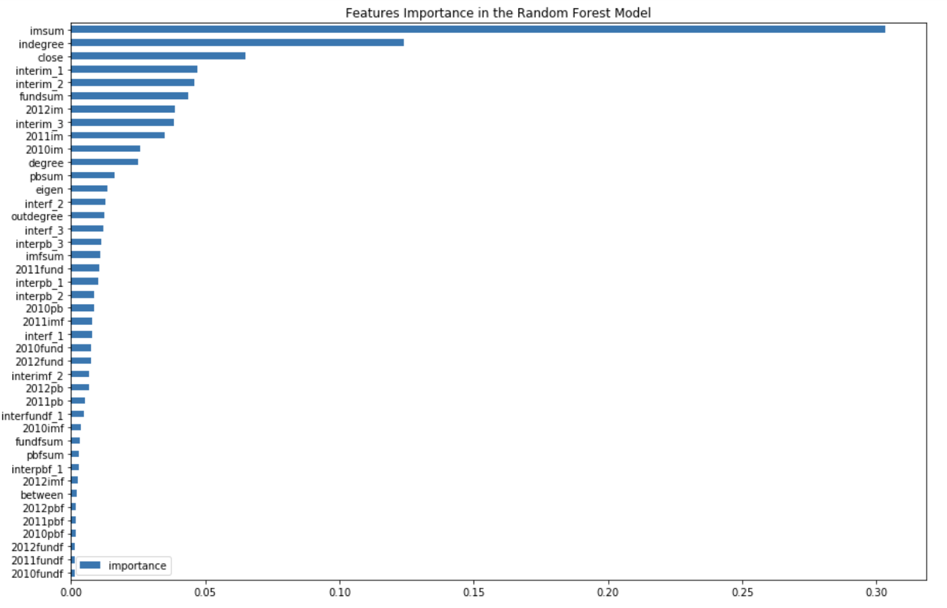
Feature Importance
Random Forest
Impact factor related features
Co – author network features

Slide 17
Modeling
 | train | test
lr | 11.2634 | 10.4566
ridge | 11.2684 | 10.3060
lasso | 11.2331 | 10.2956
elasticNet | 11.2292 | 10.2937
rf | 12.1611 | 12.9575

Slide 18
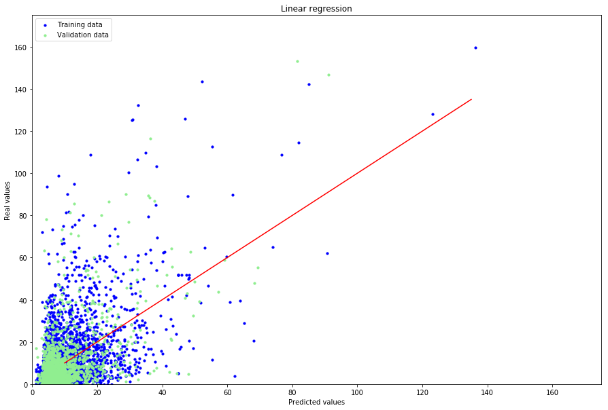
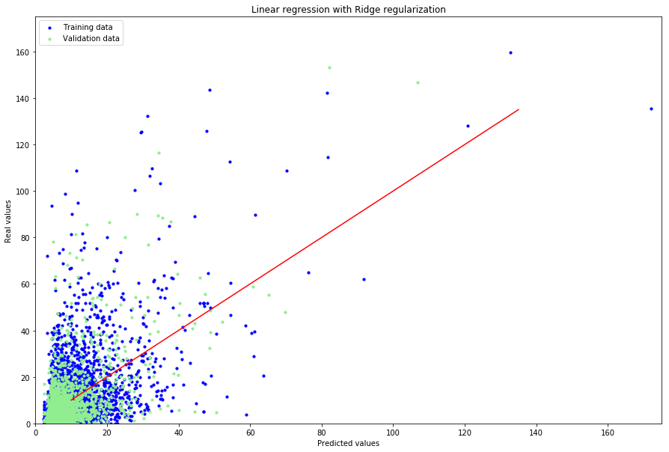

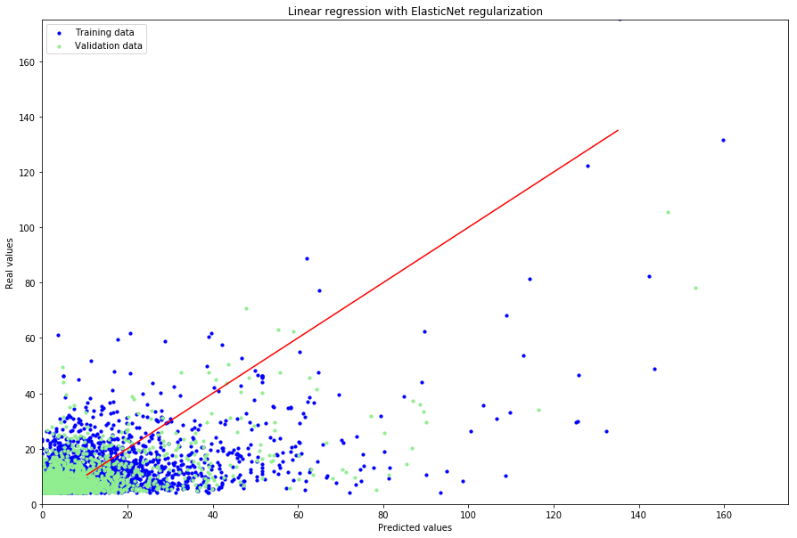
Linear Regression Result

Slide 19
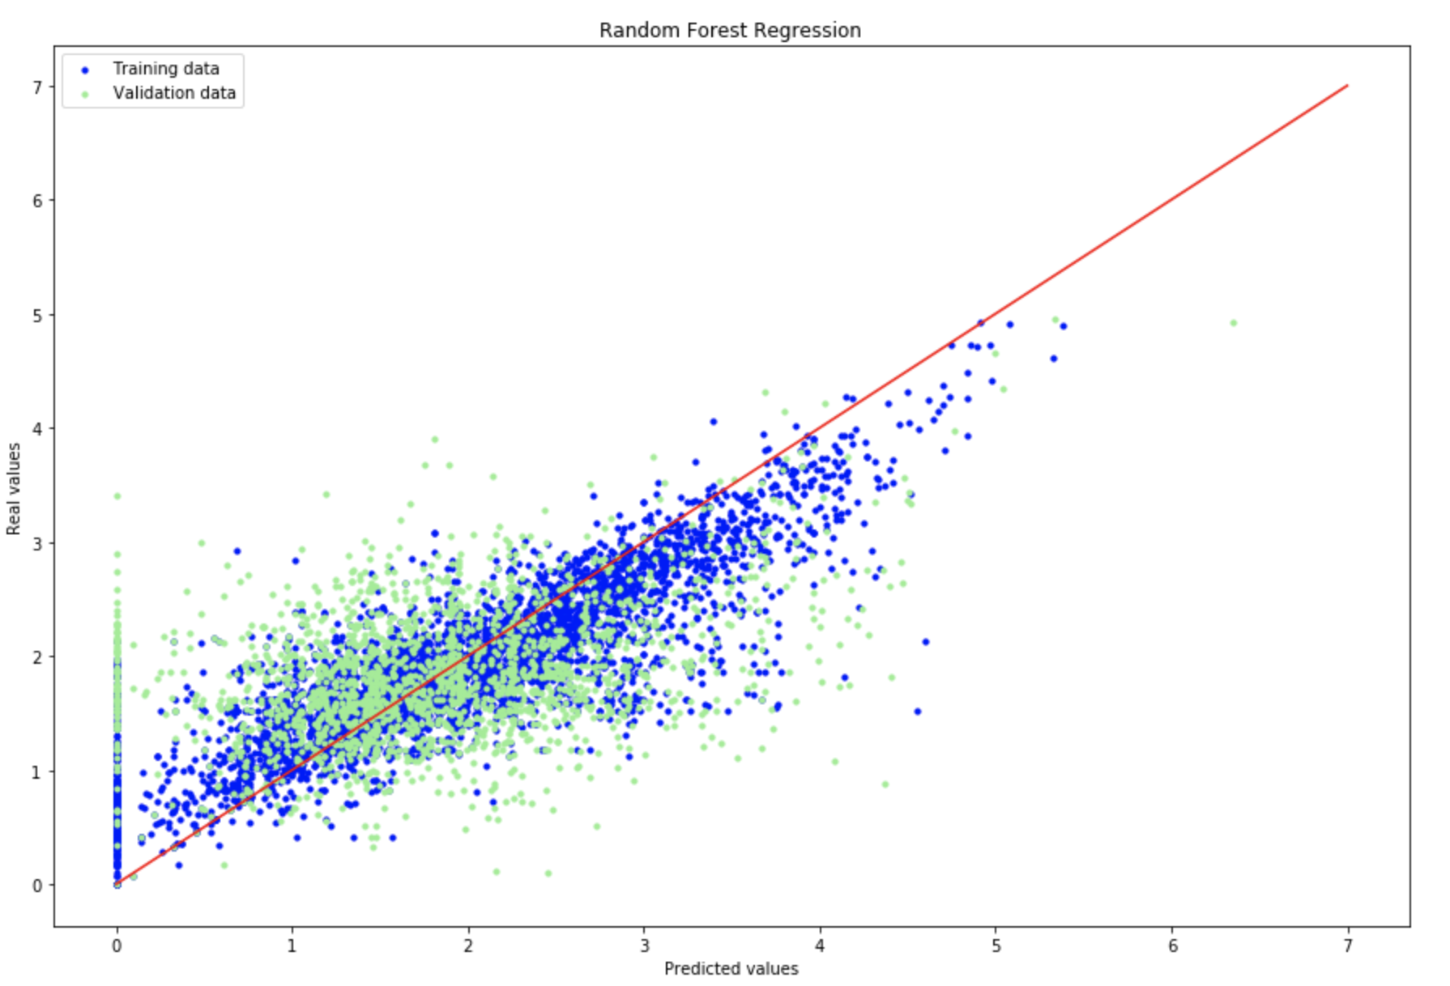
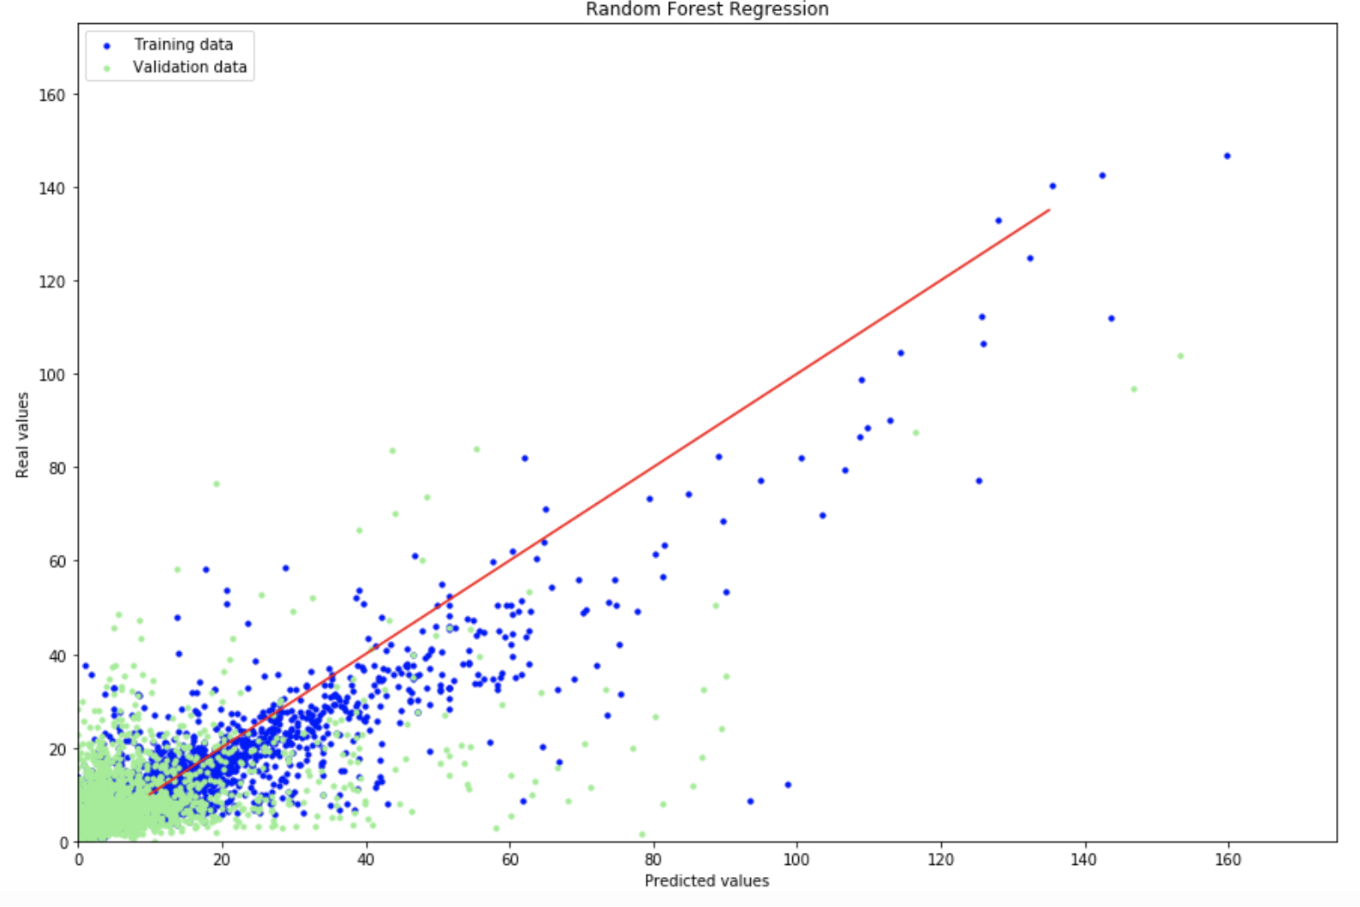
Random Forest Result
Log transform on Res variable
Original distribution of Res variable

Slide 20
Considering Ranking
These models can make great prediction on top 25 authors.
Random Forest seems more stable and has a better performance than linear regression.

Slide 21
Considering Ranking
 | Top 10 | Top 20 | Top 50 | Top 100
rf | 7 | 19 | 32 | 57
lr | 7 | 11 | 17 | 36
ridge | 7 | 11 | 16 | 33
lasso | 7 | 11 | 16 | 35
elasticNet | 7 | 11 | 16 | 35
The table shows the number of seats that these models predicted, considering real ranking top N list.
As N increasing, the ratio predicted is decreased. The ratio decreasing in Linear regression model is more significant.

Slide 22
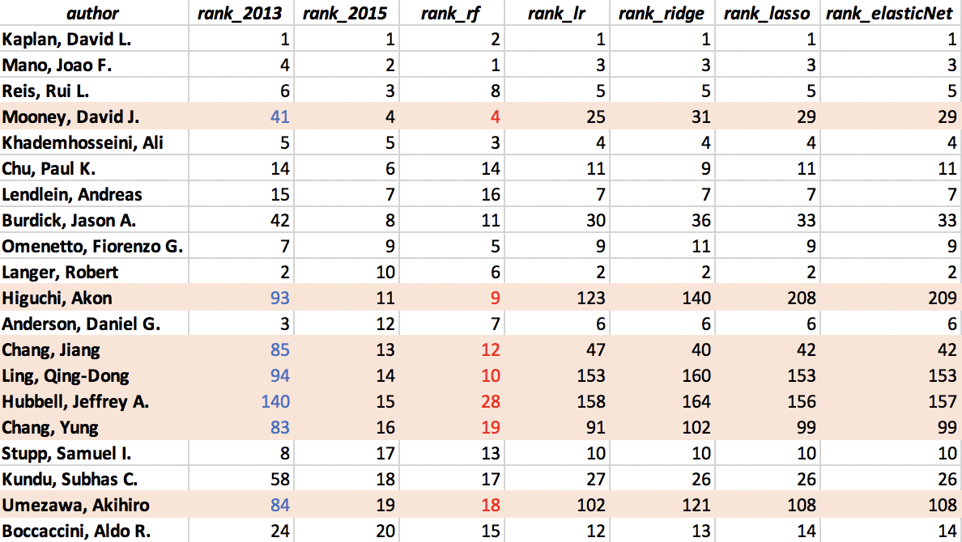
Top 20 Ranking
Random Forest has a greater performance on picking up potential top authors.

Slide 23
Conclusion
We used two kinds of regression models. Linear regression and linear regression with 3 different regularizations is more conservative than Random Forest, which explained a lower RMSE.
Random Forest with log transform is more stable than using original target distribution. However, when considering pick up top authors, log transform did not helped.
Random Forest model is more likely pick up potential top authors.
These models only have advantages in picking top authors. (under top 50)

Slide 24
Recommendations on Future work
Since we did not consider topic changing and funding was an important part of our feature space, we analyzed the data after 2010.
For future analysis, more aspects can be considered, like citation network analysis, academic year, combined with topic analysis.
Thus we can expand our time span, more authors would be taken under consideration in a long run.
In our work, we used impact factor to valuate each author’ work during a certain time period, the distribution is right skewed and that resulted in a very unstable model. For future work, other variables can be chosen to measure the quality of each author’ work, like H-index.
Tree based regression have a better performance according to our results.

Slide 25
Team member
Contribution
Hongyi Chen | Data Collecting, Feature Engineering, Poster
Yuyi Yan | Data Manipulation, EDA, Data visualization, PPT
Jiahui Bi | Impact factor Analysis, Co-author Network, Modeling
Shan Gao | Feature Engineering, Model evaluation, PPT, Poster

